Slide 1

Sun On&Off

Slide 2
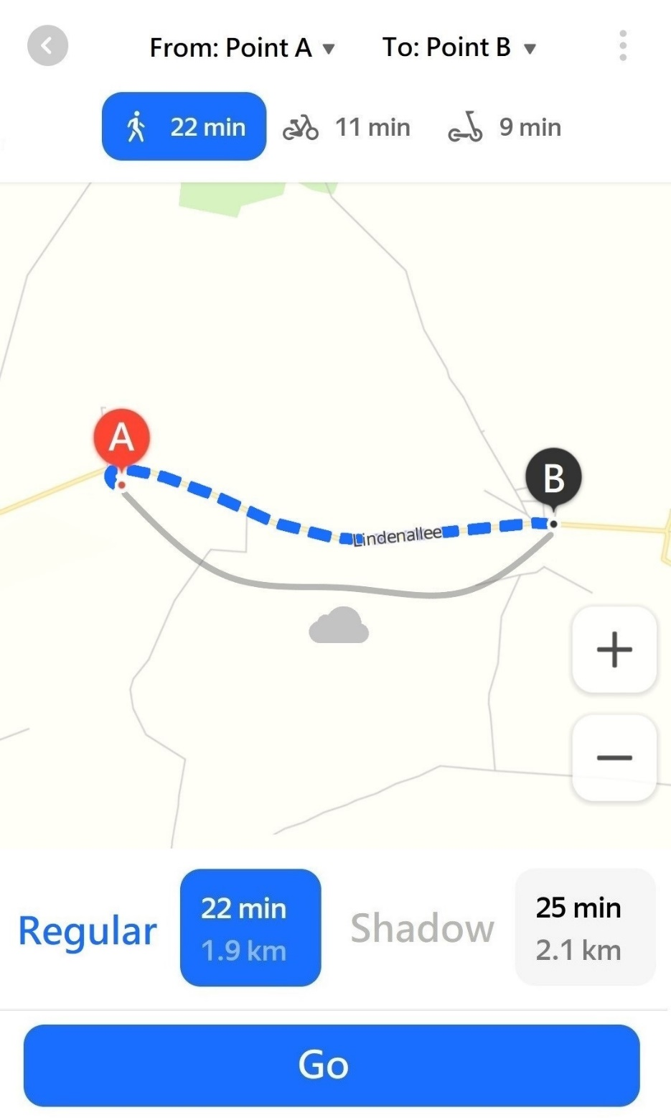
Hot? Then it’s the right time to use our shadow maps! Track how sun affects streets you plan to travel according to the time of day and where you are

Slide 3
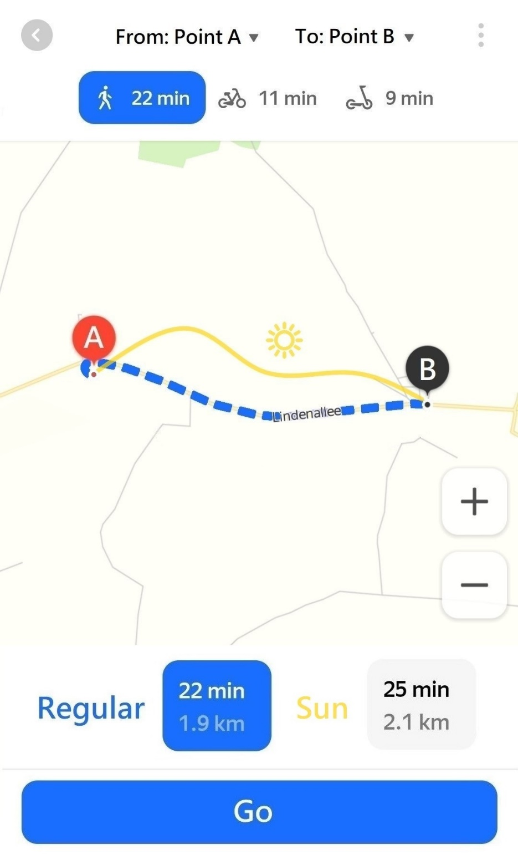
Cold? Guess what! The feature of constructing the most sunny path is also available

Slide 4
Features
Online sun position checking
Hourly updatable global sun/shadow forecast within a day
Shortest path as well as most/least sunny path around your current location
Cabin service supply

Slide 5
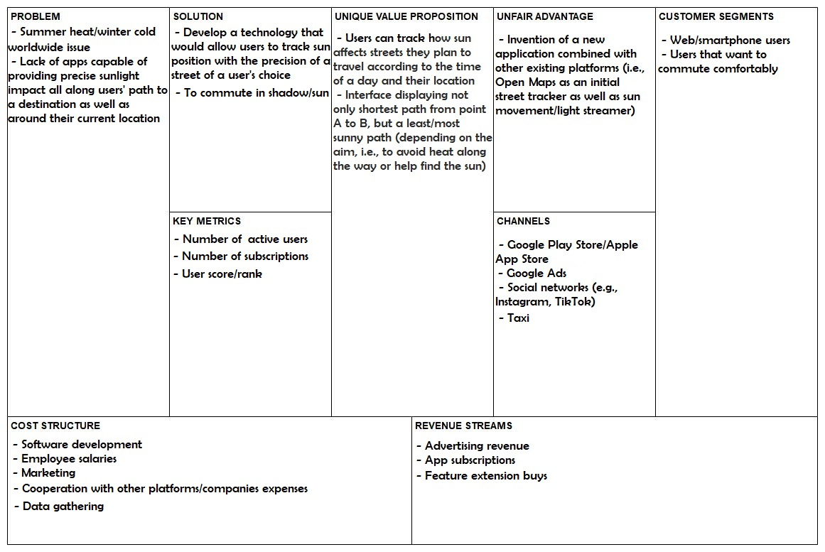
Lean Canvas

Slide 6
Market Segmentation
Our product is based on:
Geographic segmentation (seasonal segmentation)
Frequency of buying our product:
Purchase app -> Subscription -> Upgrade some features
Estimated value of our end user :
App price + ads/subscription + extended features ≈ $20
Concentration of Buyers in this market segment:
Oligopoly (there is not that many of good competitors, especially considering our main feature)
Approximate Size of Market :
Over 1M

Slide 7
Beachhead market
Geographic location: A deliberate area may define who a product should be sold to specific regions, such as warm/cold countries/regions
Customer need: There is a gap in the market, the beachhead strategy encourages businesses to research this hole and find a way to fill it based on customer needs (i.e., tracking how sun affects streets you plan to travel according to the time of day and location of a user, in our case)
Early adopters
people from warm/cold countries
travelers
people that regularly travel by foot or are into outdoor activities (e.g., sports, walking, camping).
underaged people (no driver license leads to commuting by foot more often) (e.g., pupils, teenagers)
people that do not own a car

Slide 8

Persona
The humanistic persona in our case, since is a people centered, solving problem a lot of people deal with on daily basis. The potential buyer could be someone into outdoor activities, people that have to commute by foot, travelers and people from warm/cold regions.
Example
Young traveler Barbara from Poland aims to discover Thailand this time. She faces the problem of not being used to such a hot weather, which becomes a major problem for her to wander as much as she wants to. This way Barbara notices Sun On&Off Maps Ads taking a cabin from one of her journeys once. That was the point she started looking at experiencing warm countries in a new and better way!
Barbara, 23yo

Slide 9
Usage scenarios
The app provides new features in form of additional sun position tracking as well as using this data to show a user the most/least sunny path in comparison to existing map applications
The value of such an app is planned to only increase with the time, due to raising global warming issues. Therefore, the rise of app users is expected
To achieve it, the essential aspects are to manage to cooperate with respectable platforms both – for software development and its further propagation
To attract new users or keep existing users there are several points to be considered: regular new feature announcements; ads helping making users interested in upgrading; promotion of new extensions

Slide 10

User Behaviour Analysis
Status
Craves constant traveling
No permanent job or place of stay
Personal traits
Adventurous:
Traveling more often than not involves venturing out into the unknown
It involves traveling to a new place, meeting new people and engaging in new experiences
Empathetic:
Willingness to encounter diverse cultures and people, place in memory different stories
Welcome to change:
Being surrounded by new people and new places regularly
Independent:
No need of permanent place of stay, job
Opportunities
Comfortable and less limited traveling
Extreme Traveler

Slide 11

Extreme Traveler
Needs
Differences in climates
Organism not being used to specific climates
Money/Finanse
Total income: ~ 20,000 – 30,000$ / year
Disposable income: ~ 14,000 – 21,000$ / year
Savings assets: ~ 3,000 – 4,000$ / year (i.e., 20% of disposable income)
Willing to spend: not much… (since the future is unstable while traveling - you do not know how “costly” the next country of choice is)
Degree of influence
In case of the user being travel blogger, their influence on the app recommendation distribution could get to quite high scale (by them sharing their opinion on the app)
In case of a regular user, their influence could stop on recommending the platform to their friends, etc. (that might also be into travelling)

Slide 12



User Behaviour Analysis
Status
Spends most of their life at work
Personal traits
Hardworking
Prefers to spend their vacations in a warm country, sunbath
Finds excursions an import part of any vacation
Opportunities
Comfortable and less limited traveling
More excursions to pick – ability to check sun position anytime
Needs
Differences in climates
Organism not being used to specific climates
Occasional Traveler

Slide 13
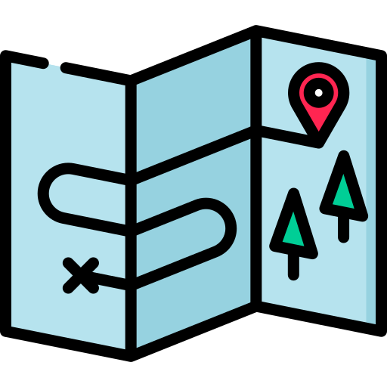
Occasional traveler
Money/Finanse
Total income: ~ 50,000 – 60,000$ / year
Disposable income: ~ 46,000 – 59,000$ / year
Savings assets: ~ 10,000 / year
Willing to spend: ready to pay for comfort of vacations that do not happen that often
Degree of influence
The influence could stop on recommending the platform to their friends, etc.

Slide 14
Product Promotion
Introductory Offers
Low-price subscription
Partnership / Guest Blogging
Other businesses (e.g., taxi services)
Bloggers (e.g., travel-related ones)
Google Ads
PPC (Pay-Per-Click) Advertising
Launching a search ads campaign
Mobile Application Review Site

Slide 15
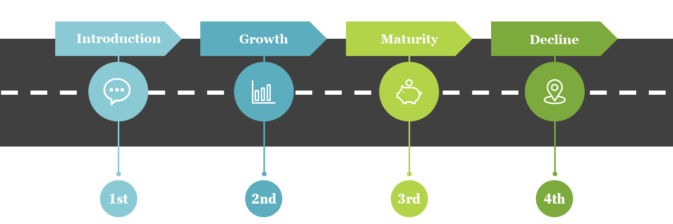
Product Lifecycle

Slide 16





Introduction
An initial low pricing policy to get into the market is going to be introduced
The product is going to be distributed directly to customers with an automated purchase process via various app store platforms (Play Market, App Store, etc.)
Product promotion is going to be firstly aimed at taxi services, Google Ads

Slide 17






Growth
Adding extra services (extensions/features)
Keeping the price at a good level to maintain sales growth
Marketing campaigns aimed at a broader audience by travel blogger partnerships, advertising on social networks, weather forecast applications

Slide 18





Maturity
Adding features that will make the product differ from the inevitable competitors (e.g., taxi service partnership)
Cutting price to counter competition
New promotions that aim to show differences between products
NO SUN TRACKING/TAXI SERVISE

Slide 19




Decline
Keeping the product on the market but adding or removing features or finding new uses for it (propagating implemented taxi service)
Reducing pricing policy
Discontinuing the product or selling the production rights to another company

Slide 20
App Prototype

Slide 21
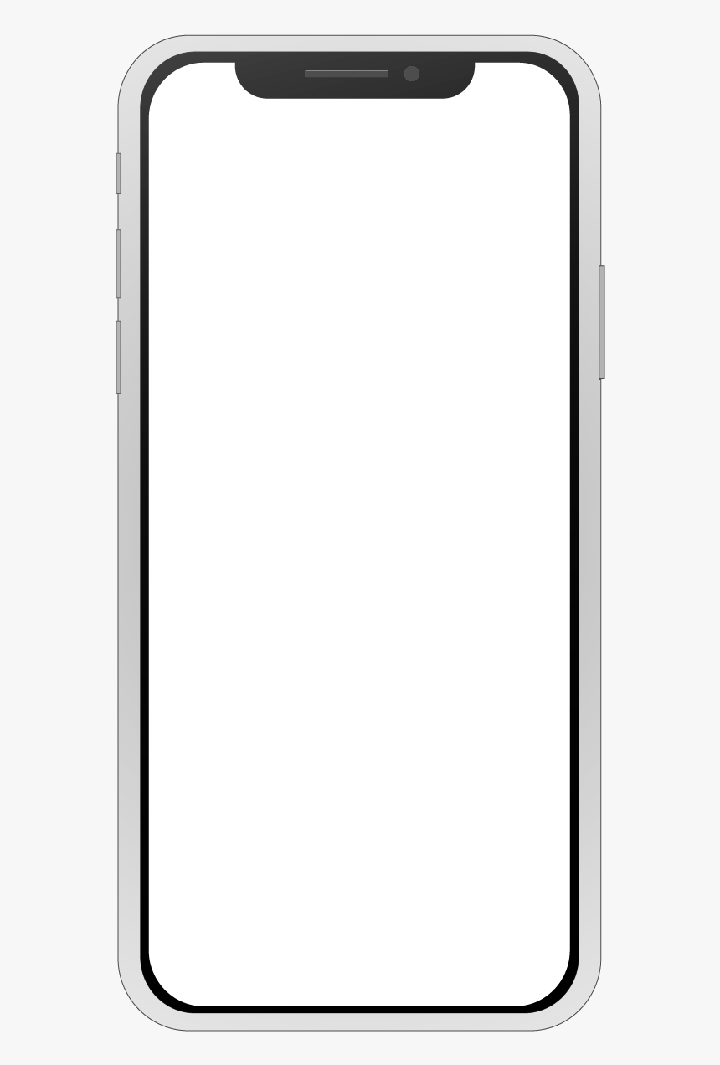
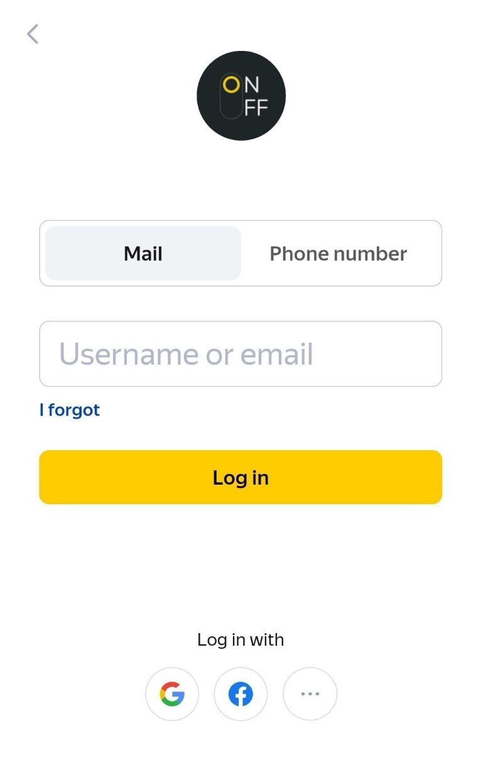
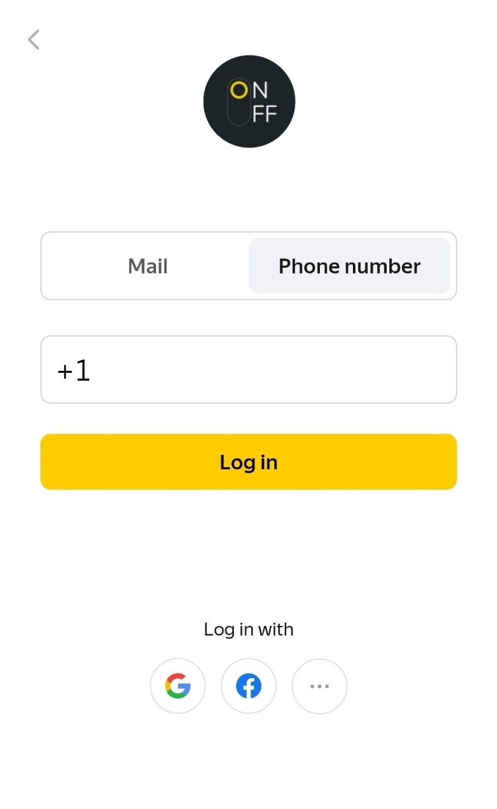

Slide 22
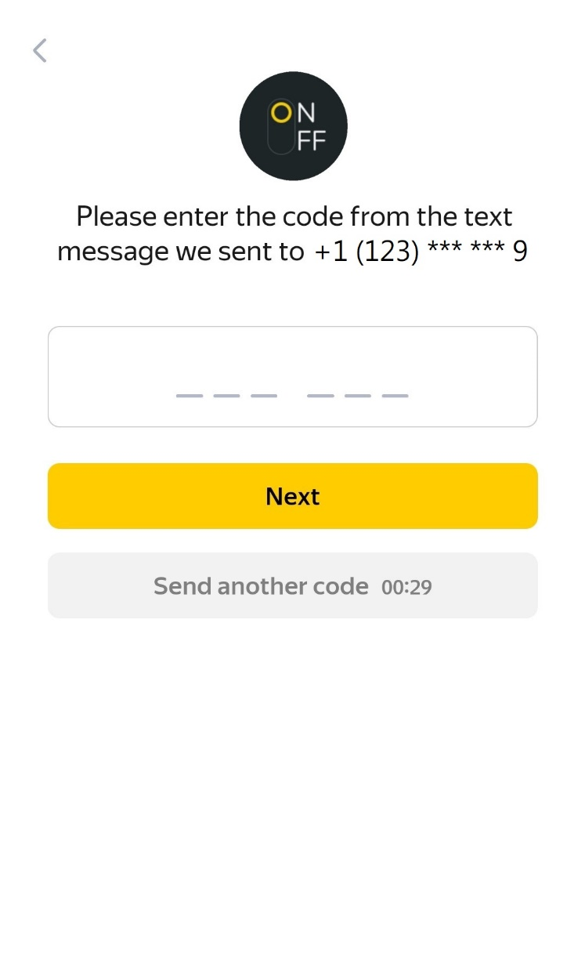

Slide 23

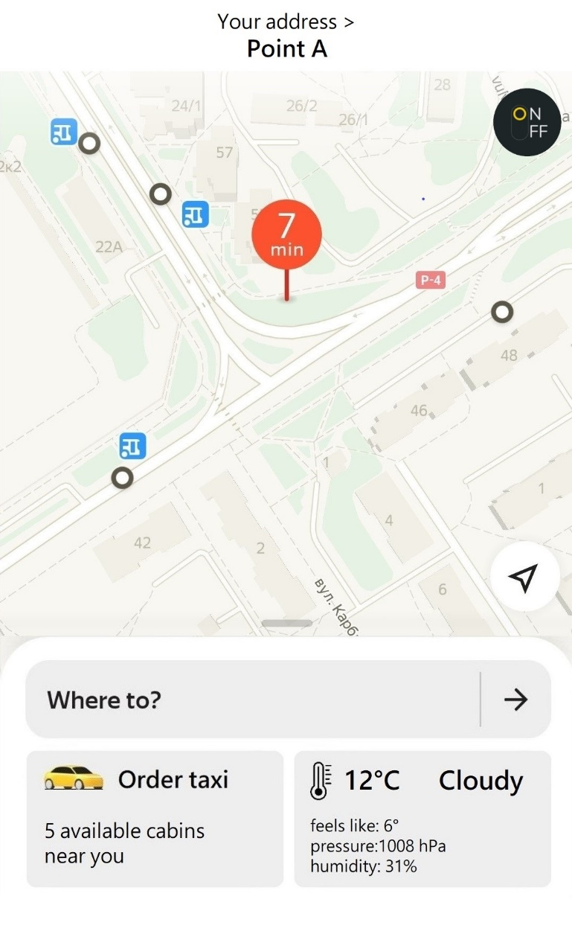
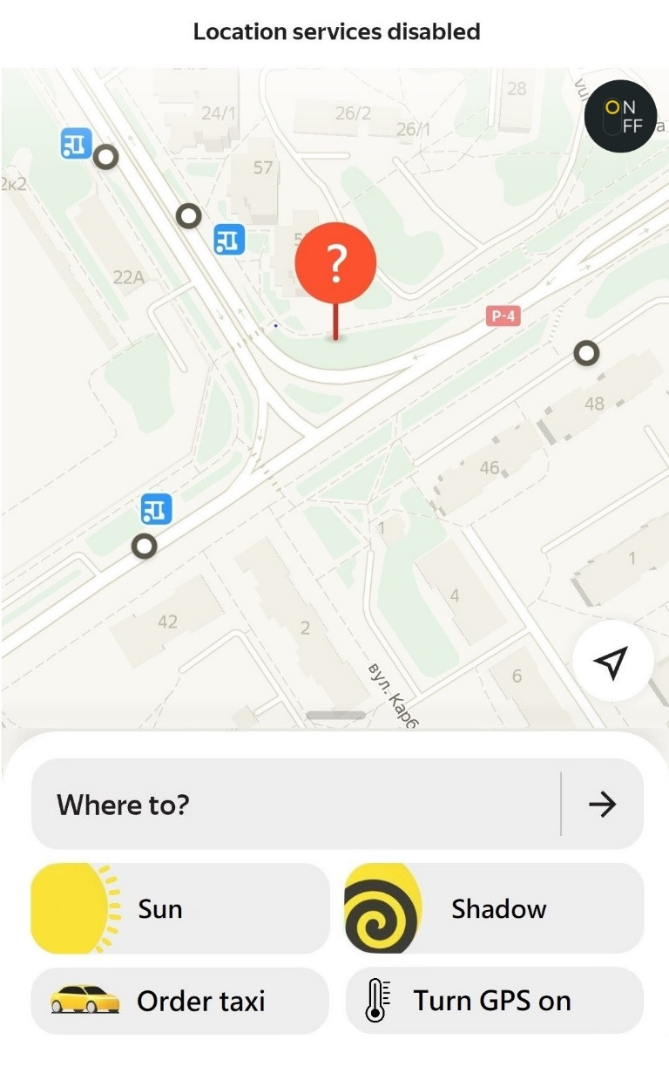

Slide 24

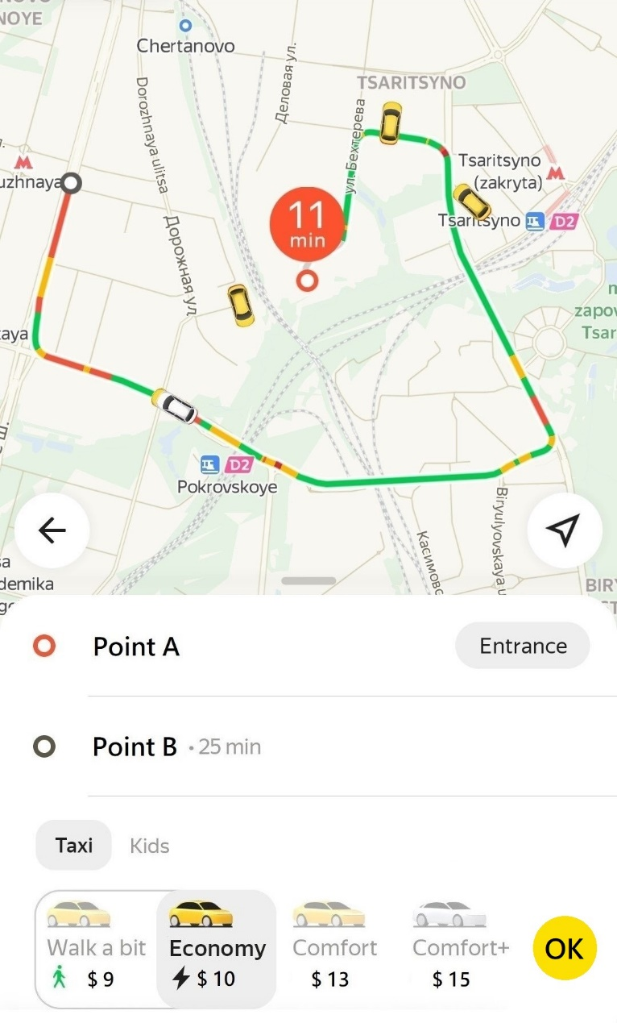

Slide 25


89%
73%

Slide 26
Key assumptions
Demonstrate the need for our product in the marketplace
What are the current options to dealing with the problem?
Why our product will be chosen over the current solution (what are the benefits for users)?
Demonstrate Profitability
Do we pay off our initial costs to develop the product?
Management Expertise
Are we able to manage all business aspects throughout the phases?

Slide 27
Main question
Would people really like to improve the current situation?

Slide 28
Need in the marketplace
As for now, people deal with the problem by
Finding shadow
Using umbrella
Staying under tree/other shelter
Staying at home
Why our shadow maps is the beneficial to a user
No need of looking for a shadow on your own - may be challenging sometimes
User can be sure the sun presence is indeed minimized/maximized throughout the whole path shown in the app - reduces the chances of “losing” shadow on your way
Same simple to use as any other regular maps - no need of adapting to a new technology
App is “All-in-One” – cabin services is available as well, no need of installing any other app

Slide 29
Where are the proofs?
In order to prove the pros for a user to use our app, we have conducted two surveys:
Among average people (from warm/cold regions that have to somehow commute by foot)
Among active travelers

Slide 30
Survey details
The survey was conducted:
Among average people - total 12’518 participants:
8’104 from Brazil
4’414 from Iceland
Among travelers - total of 305’091 participants around the world

Slide 31
Survey results
Conclusions
Among average people:
- Cold region (Iceland):
The need is moderate
- Warm region (Brazil): Clear need of it
Among travelers:
Strong need of it
 | Average people |  | Travelers
Options | Iceland | Brazil | Around the world
No strong need on daily basis, but absolutely would be beneficial in some cases | 41% | 35% | 30%
No need at all | 27% | 24% | 11%
I have a strong need | 31% | 41% | 59%

Slide 32
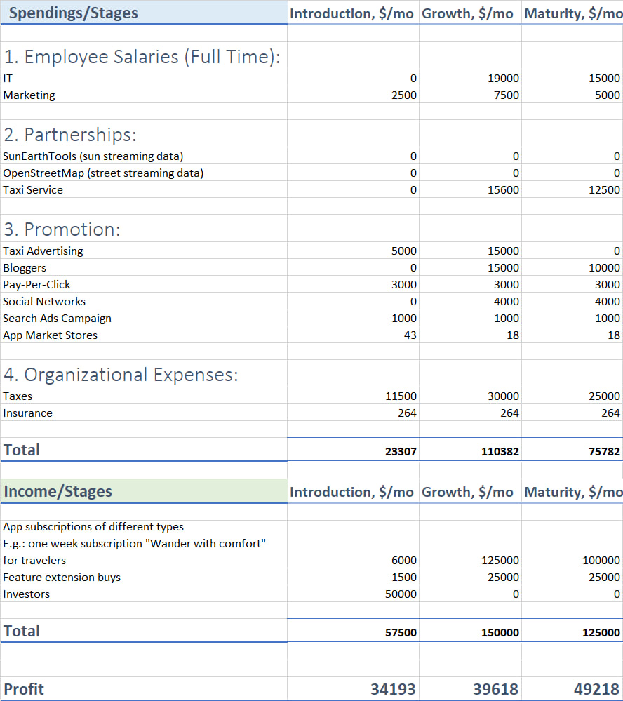
Let us reference our Financial Model that concerns three following stages:
Introduction
Growth
Maturity

Slide 33
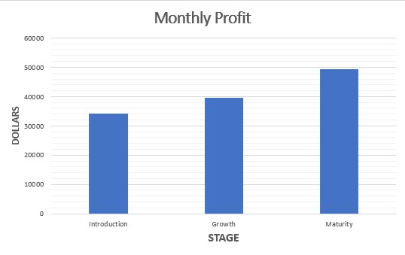
Demonstrate Profitability
Resulting plot shows the increase in profit from our product
The gradual increase of it proves the product Profitability

Slide 34
Management Expertise
The preceding Financial Model also considers all the needed
personnel / employees
partnerships
promotion
organizational
aspects, as well as amount of each of the units
The product Profitability, proved on the previous slide, encounters these aspects, meaning that all the required resources will be satisfied throughout whole product lifecycle

Slide 35
Therefore
Our Sun On&Off Maps were found:
Profitable
Needed in market
Manageable
So… Are you interested?

Slide 36
Thank you!

